Slide 1
Chapter 4 Data Structures, Objects and Arrays

Slide 2
Data sets
Fortunately, JavaScript provides a data type specifically for storing sequences of values. It is called an array and is written as a list of values between square brackets, separated by commas.
let listOfNumbers = [2, 3, 5, 7, 11];
console.log(listOfNumbers[2]);
// → 5
console.log(listOfNumbers[0]);
// → 2
console.log(listOfNumbers[2 - 1]);
// → 3
Notes:
The notation for getting at the elements inside an array also uses square
brackets. A pair of square brackets immediately after an expression, with
another expression inside of them, will look up the element in the left-hand
expression that corresponds to the index given by the expression in the brackets.

Slide 3
The first index of an array is zero, not one.
So the first element is retrieved with listOfNumbers[0]. Zero-based counting has a long tradition in technology and in certain ways makes a lot of sense, but it takes some getting used to.

Slide 4
Properties
Almost all JavaScript values have properties. The exceptions are null and undefined. If you try to access a property on one of these nonvalues, you get an error.
null.length;
// → TypeError: null has no properties
The two main ways to access properties in JavaScript are with a dot and with square brackets.
Both value.x and value[x] access a property on value—but
not necessarily the same property.
Notes:
We’ve seen a few suspicious-looking expressions like myString.length (to get
the length of a string) and Math.max (the maximum function) in past chapters.
These are expressions that access a property of some value. In the first case,
we access the length property of the value in myString. In the second, we
access the property named max in the Math object (which is a collection of
mathematics-related constants and functions).
The difference is in how x is interpreted.
When using a dot, the word after the dot is the literal name of the property.
When using square brackets, the expression between the brackets is evaluated to
get the property name. Whereas value.x fetches the property of value named
“x”, value[x] tries to evaluate the expression x and uses the result, converted
to a string, as the property name.
So if you know that the property you are interested in is called color, you say
value.color. If you want to extract the property named by the value held in
the binding i, you say value[i]. Property names are strings. They can be any
string, but the dot notation works only with names that look like valid binding
names. So if you want to access a property named 2 or John Doe, you must
use square brackets: value[2] or value["John Doe"].
The elements in an array are stored as the array’s properties, using numbers
as property names. Because you can’t use the dot notation with numbers and
usually want to use a binding that holds the index anyway, you have to use the
bracket notation to get at them.
The length property of an array tells us how many elements it has. This
property name is a valid binding name, and we know its name in advance, so
to find the length of an array, you typically write array.length because that’s
easier to write than array["length"].

Slide 5
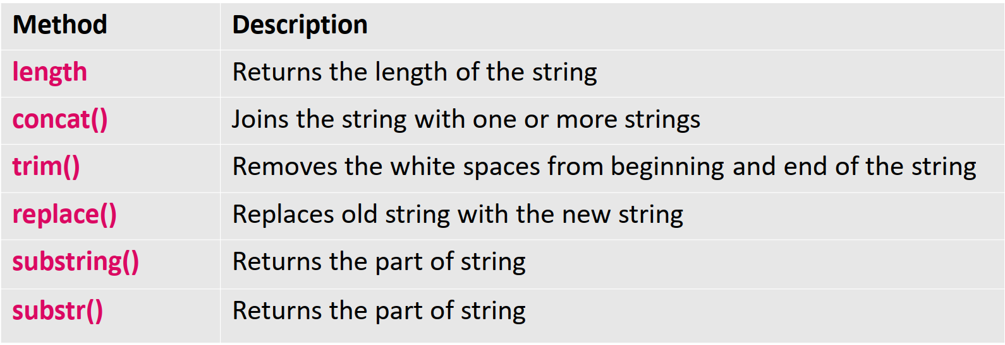
Strings Methods

Slide 6
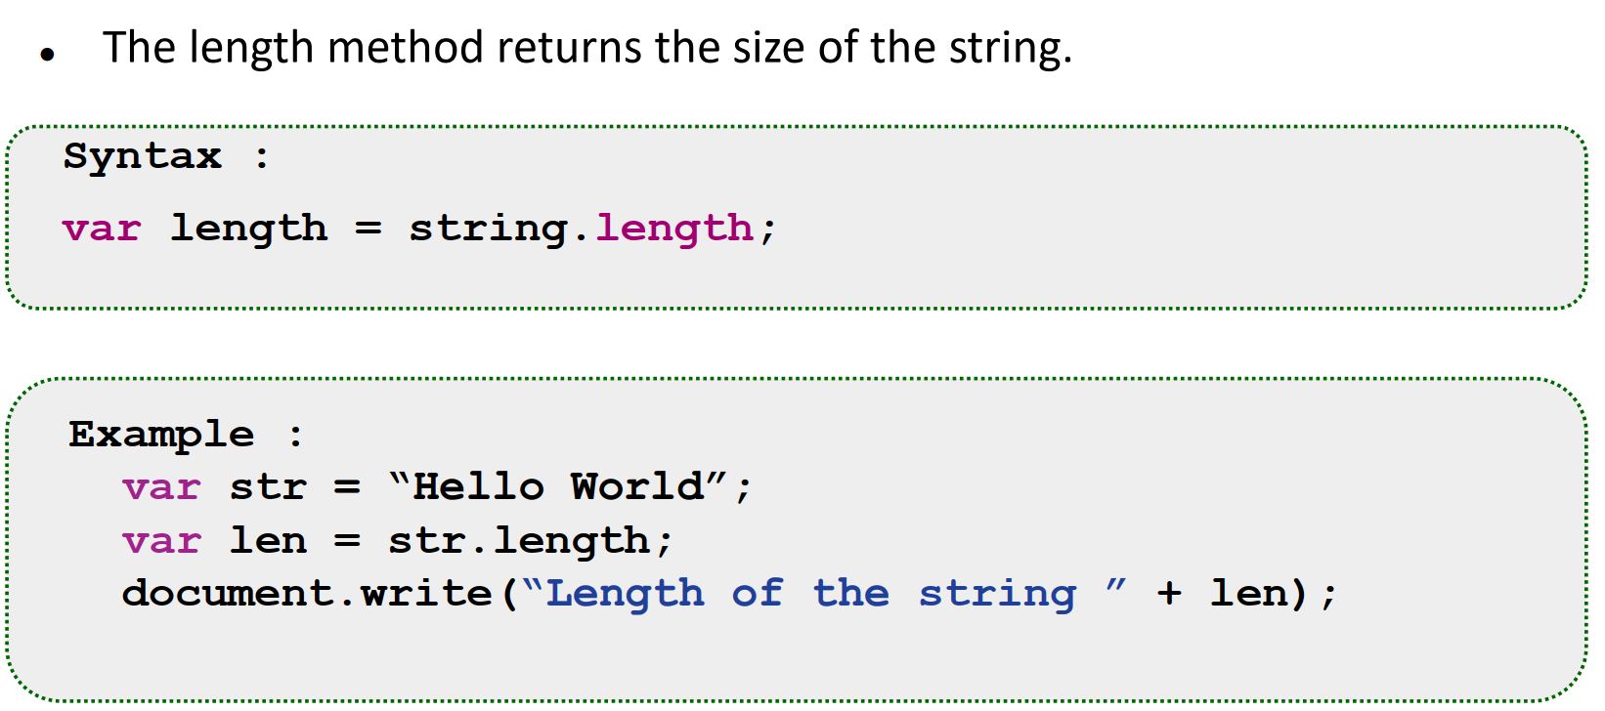
The length() Method

Slide 7
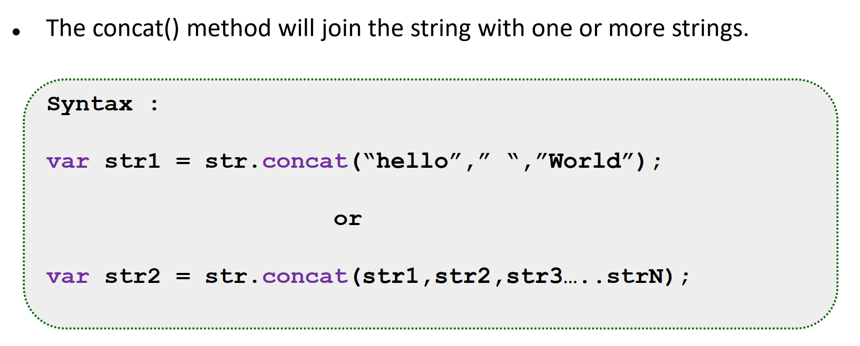
The concat() Method

Slide 8
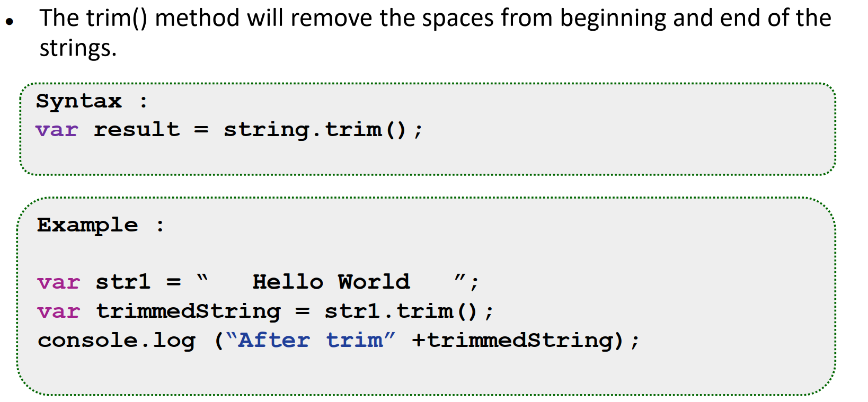
The trim() Method

Slide 9
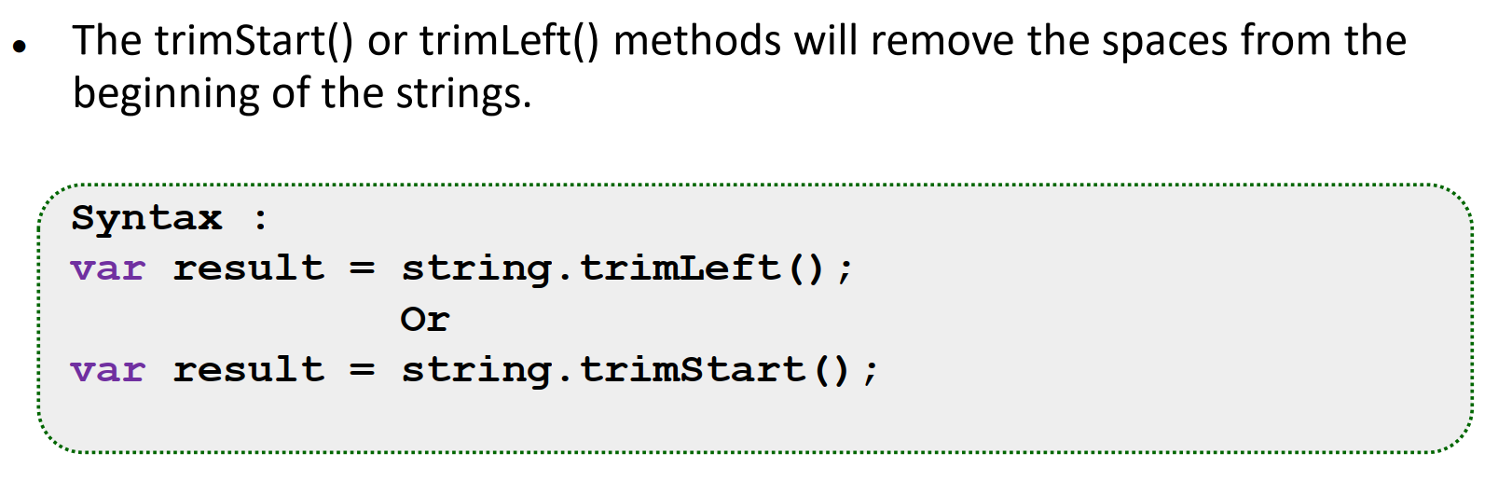
The trimStart() or trimLeft() Method

Slide 10
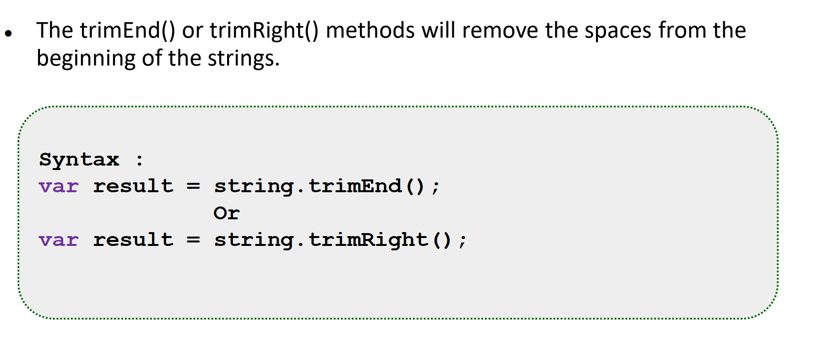
The trimEnd() or trimRight() Method

Slide 11
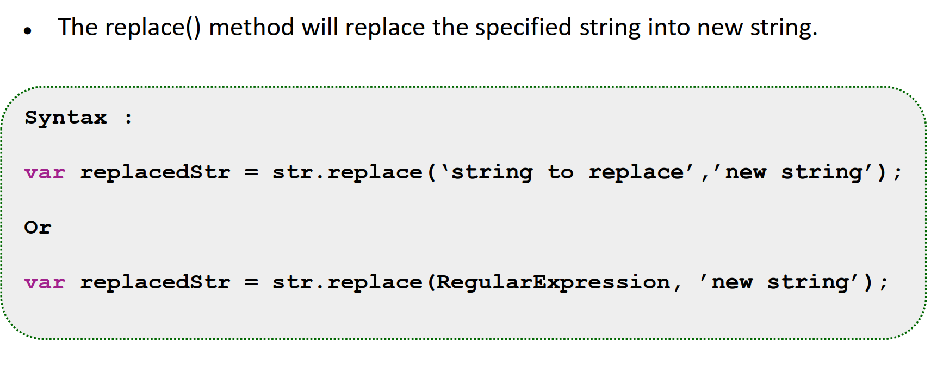
The replace() Method

Slide 12
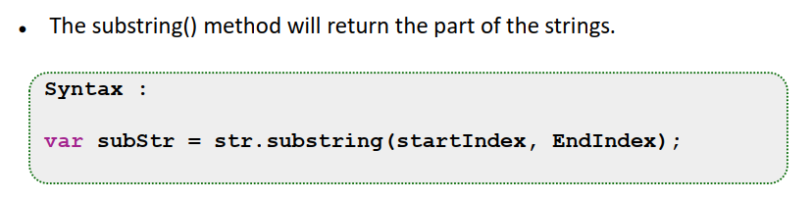
The substring() Method

Slide 13
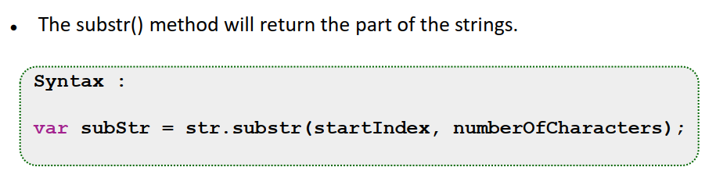
The substr() Method

Slide 14
Join and split
You can split a string on every occurrence of another string with split and join it again with join.
let sentence = "Secretarybirds specialize in stomping";
let words = sentence.split(" ");
console.log(words);
// → ["Secretarybirds", "specialize", "in", "stomping"]
console.log(words.join(". "));
// → Secretarybirds. specialize. in. stomping

Slide 15
repeat
A string can be repeated with the repeat method, which creates a new string containing multiple copies of the original string, glued together.
console.log("LA".repeat(3));
// → LALALA

Slide 16
length
We have already seen the string type’s length property. Accessing the individual characters in a string looks like accessing array elements.
let string = "abc";
console.log(string.length);
// → 3
console.log(string[1]);
// → b

Slide 17
Methods
Both string and array objects contain, in addition to the length property, a number of properties that hold function values.
let doh = "Doh";
console.log(typeof doh.toUpperCase);
// → function
console.log(doh.toUpperCase());
// → DOH
Every string has a toUpperCase property. When called, it will return a copy of the string in which all letters have been converted to uppercase. There is also toLowerCase, going the other way.
Notes:
Interestingly, even though the call to toUpperCase does not pass any arguments,
the function somehow has access to the string "Doh", the value whose
property we called.

Slide 18
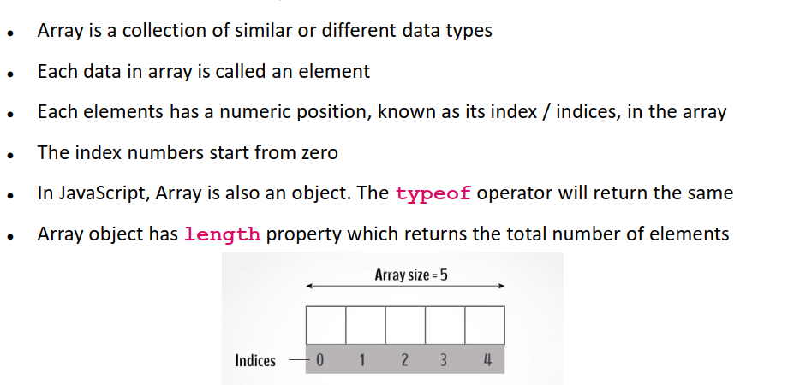
What is an Array

Slide 19
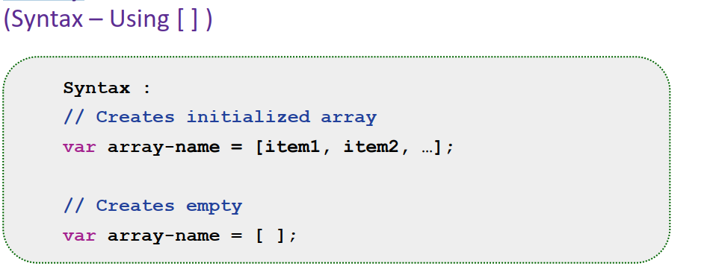
Array

Slide 20
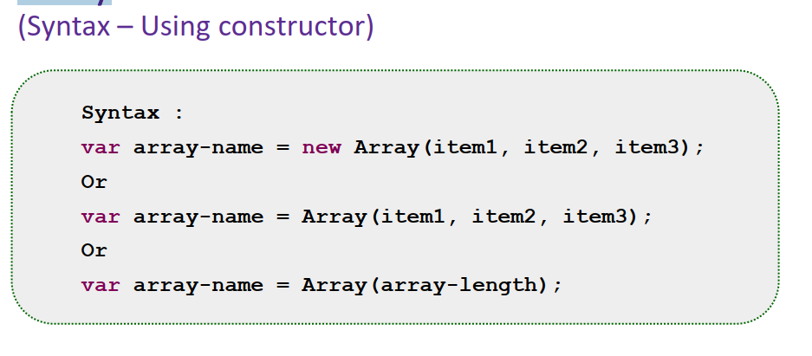
Array

Slide 21
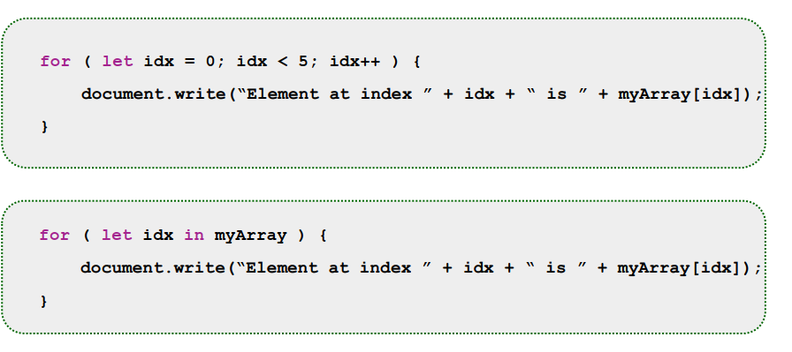
Array Access – Using loop

Slide 22
Exercise
▪ Sum of all number ▪ Average ▪ Maximum value & Minimum value
Splice Function

Slide 23
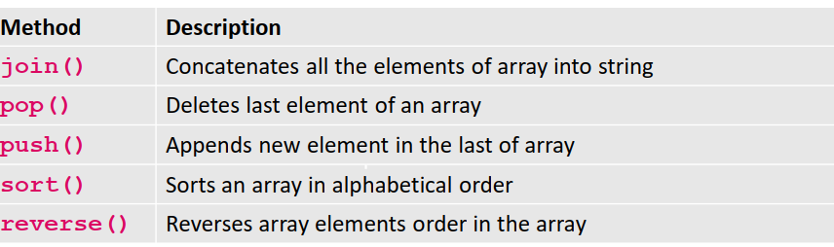
Array Methods

Slide 24
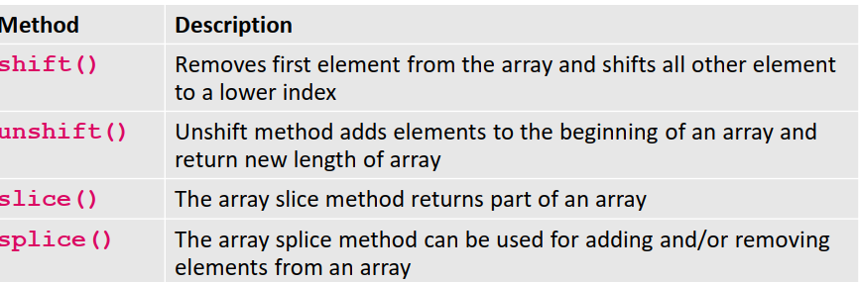
Array Methods

Slide 25
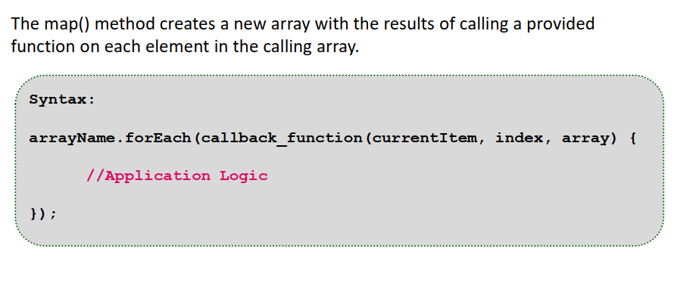
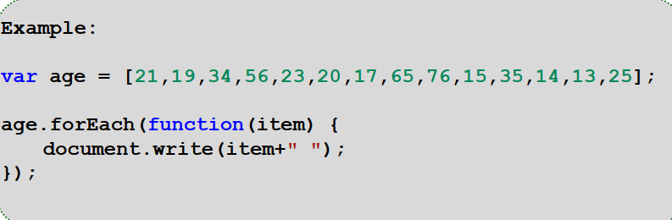
TheforEach() Method

Slide 26
Con…
Properties that contain functions are generally called methods of the value
they belong to, as in “toUpperCase is a method of a string”.
This example demonstrates two methods you can use to manipulate arrays:
let sequence = [1, 2, 3];
sequence.push(4);
sequence.push(5);
console.log(sequence);
// → [1, 2, 3, 4, 5]
console.log(sequence.pop());
// → 5
console.log(sequence);
// → [1, 2, 3, 4]
Notes:
The push method adds values to the end of an array, and the pop method
does the opposite, removing the last value in the array and returning it.
These somewhat silly names are the traditional terms for operations on a
stack. A stack, in programming, is a data structure that allows you to push
values into it and pop them out again in the opposite order so that the thing
that was added last is removed first.

Slide 27
Objects
Values of the type object are arbitrary collections of properties. One way to
create an object is by using braces as an expression.
let day1 = {
squirrel: false,
events: ["work", "touched tree", "pizza", "running"]
};
console.log(day1.squirrel);
// → false
console.log(day1.wolf);
// → undefined
day1.wolf = false;
console.log(day1.wolf);
// → false

Slide 28
Example
var emp = new Object();
emp.id = 101;
emp.name = "Mohamed";
emp.salary = 90;
console.log(emp.id+" "+emp.name+" "+emp.salary);

Slide 29
Example
// javascript code demonstrating a simple object
let school = {
name: ‘JUST School',
location : ‘Mogadishu',
established : ‘2011',
displayInfo : function(){
console.log(`${school.name} was established in ${school.established} at ${school.location}`);
}}
school.displayInfo();

Slide 30
Con…
The delete operator cuts off a tentacle from such an octopus. It is a unary
operator that, when applied to an object property, will remove the named
property from the object. This is not a common thing to do, but it is possible.
let anObject = {left: 1, right: 2};
console.log(anObject.left);
// → 1
delete anObject.left;
console.log(anObject.left);
// → undefined
console.log("left" in anObject);
// → false
console.log("right" in anObject);
// → true

Slide 31
Con…
There’s an Object.assign function that copies all properties from one object into another.
let objectA = {a: 1, b: 2};
Object.assign(objectA, {b: 3, c: 4});
console.log(objectA);
// → {a: 1, b: 3, c: 4}

Slide 32
Arrays, then, are just a kind of object specialized for storing sequences of things. If you evaluate typeof [], it produces "object". You can see them as long, flat octopuses with all their tentacles in a neat row, labeled with numbers.
We will represent the journal that Jacques keeps as an array of objects.
let journal = [
{events: ["work", "touched tree", "pizza",
"running", "television"],
squirrel: false},
{events: ["work", "ice cream", "cauliflower",
"lasagna", "touched tree", "brushed teeth"],
squirrel: false},
{events: ["weekend", "cycling", "break", "peanuts",
"beer"],
squirrel: true},
/* and so on... */
];

Slide 33
Array loops
let users = [
{
id:1,
name:"king"
},
{
id:2,
name:"john"
},
{
id:3,
name:"gowtham"
}
]
for(let user of users){
console.log(user.id,user.name)
}

Slide 34
Using ForEach loop
let users = [
{
id:1,
name:"king"
},
{
id:2,
name:"john"
},
{
id:3,
name:"gowtham"
}
]
users.forEach(function(user){
console.log(user.id,user.name);
})

Slide 35
Strings and their properties
We can read properties like length and toUpperCase from string values. But if you try to add a new property, it doesn’t stick.
let kim = "Kim";
kim.age = 88;
console.log(kim.age);
// → undefined

Slide 36
Values of type string, number, and Boolean are not objects, and though
the language doesn’t complain if you try to set new properties on them, it
doesn’t actually store those properties.
But these types do have built-in properties. Every string value has a number
of methods. Some very useful ones are slice and indexOf, which resemble the array methods of the same name.
console.log("coconuts".slice(4, 7));
// → nut
console.log("coconut".indexOf("u"));
// → 5

Slide 37
console.log("one two three".indexOf("ee"));
// → 11
The trim method removes whitespace (spaces, newlines, tabs, and similar characters) from the start and end of a string.
console.log(" okay \n ".trim());
// → okay

Slide 38
JSON
JSON (JavaScript Object Notation) is a lightweight data-interchange format. It is easy for humans to read and write. It is easy for machines to parse and generate. It is based on a subset of the JavaScript Programming Language Standard ECMA-262 3rd Edition - December 1999. JSON is a text format that is completely language independent but uses conventions that are familiar to programmers of the C-family of languages, including C, C++, C#, Java, JavaScript, Perl, Python, and many others. These properties make JSON an ideal data-interchange language.

Slide 39
JSON
What we can do is serialize the data. That means it is converted into a
flat description. A popular serialization format is called JSON (pronounced
“Jason”), which stands for JavaScript Object Notation. It is widely used as a
data storage and communication format on the Web, even in languages other
than JavaScript.
Notes:
Because properties only grasp their value, rather than contain it, objects and
arrays are stored in the computer’s memory as sequences of bits holding the
addresses—the place in memory—of their contents. So an array with another
array inside of it consists of (at least) one memory region for the inner array,
and another for the outer array, containing (among other things) a binary
number that represents the position of the inner array.
If you want to save data in a file for later or send it to another computer over
the network, you have to somehow convert these tangles of memory addresses
to a description that can be stored or sent. You could send over your entire
computer memory along with the address of the value you’re interested in, I
suppose, but that doesn’t seem like the best approach.

Slide 40
Con…
JSON looks similar to JavaScript’s way of writing arrays and objects, with a
few restrictions. All property names have to be surrounded by double quotes, and only simple data expressions are allowed—no function calls, bindings, or anything that involves actual computation. Comments are not allowed in JSON.
A journal entry might look like this when represented as JSON data:
{
"squirrel": false,
"events": ["work", "touched tree", "pizza", "running"]
}

Slide 41
Con…
JavaScript gives us the functions JSON.stringify and JSON.parse to convert
data to and from this format. The first takes a JavaScript value and returns
a JSON-encoded string. The second takes such a string and converts it to the value it encodes.
let string = JSON.stringify({squirrel: false,
events: ["weekend"]});
console.log(string);
// → {"squirrel":false,"events":["weekend"]}
console.log(JSON.parse(string).events);
// → ["weekend"]

